Slide 1
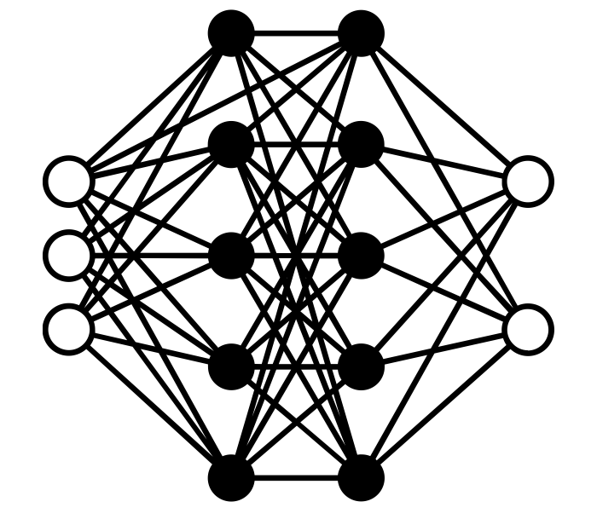
Sign Language Generation
SPEECH TO
Deekshith Machidi
Vinay Kumar Posina
Monish Kamal Bathini

Slide 2
List of contents:
Project objective
American Sign Language, why Deep Learing and challenges faced by Deep Learning
Voice to Text models, why Whisper?
Diffusion models
Dataset used
Preprocessing
Modelling
Stable Diffusion models
Results or metrics
Conclusion

Slide 3






36%
Direct costs
During 2007-08, in the US
$2.1 billion
Doctor visits, prescription drugs, and inpatient hospital stays
$652 M
Is the expected lifetime costs for all people with hearing loss who were born in a year will total
Home modifications
were spent on special education programs for children who were deaf or hard of hearing
Special Education

Slide 4


64%
inDirect costs
During 2007-08, in the US
$2.1 billion
Lost wages when a person cannot work OR limited in the amount or type of work he or she can do.
$652 M
Is the expected lifetime costs for all people with hearing loss who were born in a year will total
were spent on special education programs for children who were deaf or hard of hearing
Cost of sign language interpreters

Slide 5
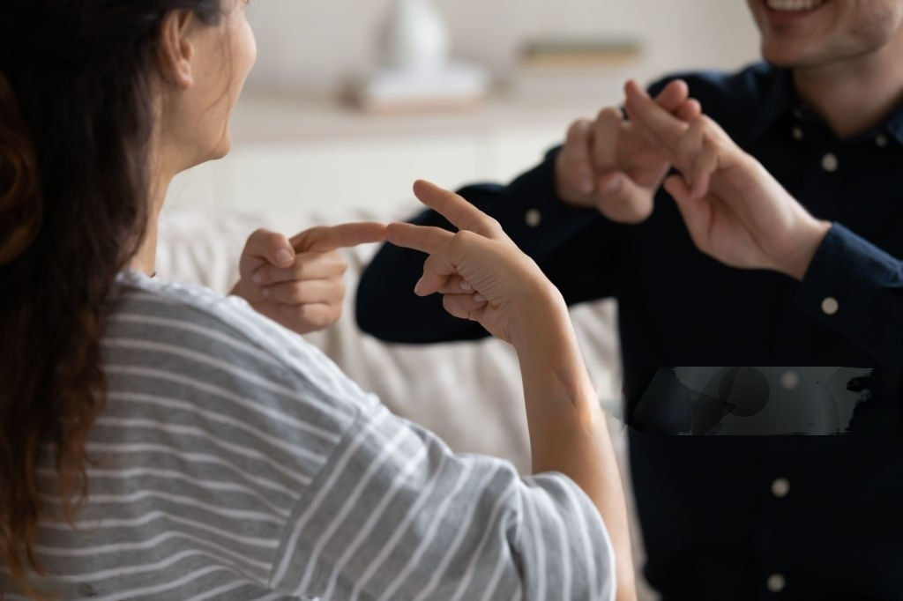
PROJECT OBJECTIVE
To bring down the Indirect cost experienced
Effort to bridge the communication gap between deaf and normal people
To help the hard of hearing people interpret the general communication without a sign language interpreter
Generate a series of sign language images (ASL) From audio/voice using a Diffusion model
Notes:
ASL interpreter to deaf ratio, 50:1

Slide 6




Process Flow
Audio
Text
Images

Slide 7




Process Flow
Images
Whisper
Audio/ voice
Diffusion
Text

Slide 8

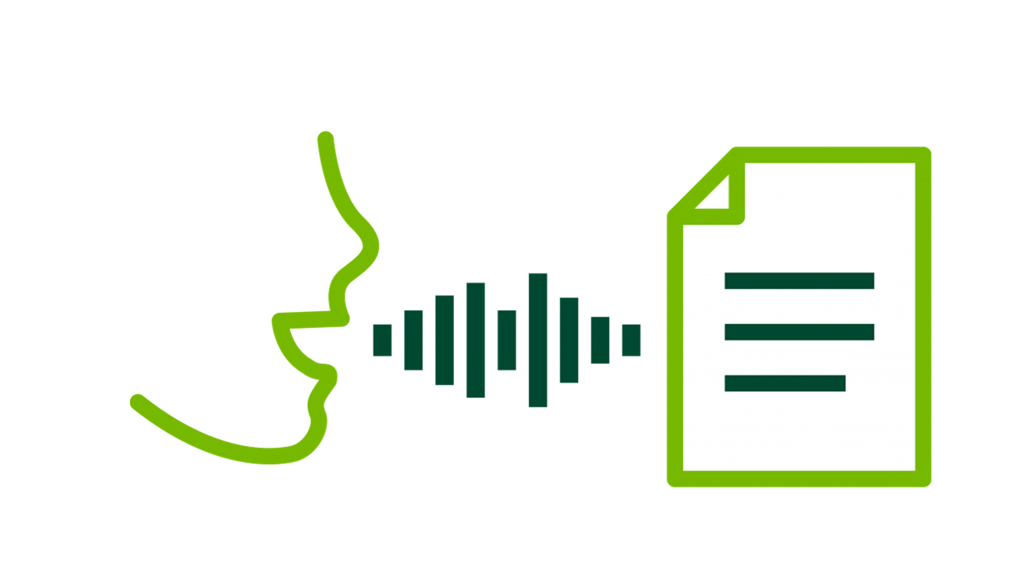
Whisper Model
Whisper AI is a speech-to-text model developed by open AI.
Whisper is an automatic speech recognition(ASR) system trained on 680,000 hours of multilingual and multitask supervised data
It has added robustness to accents, background noise and technical sound analysis.
It has enabled transcription for multiple languages
Useful for Many Things: Helps with writing out spoken words in real-time, learning tools, and making information easier to access.

Slide 9
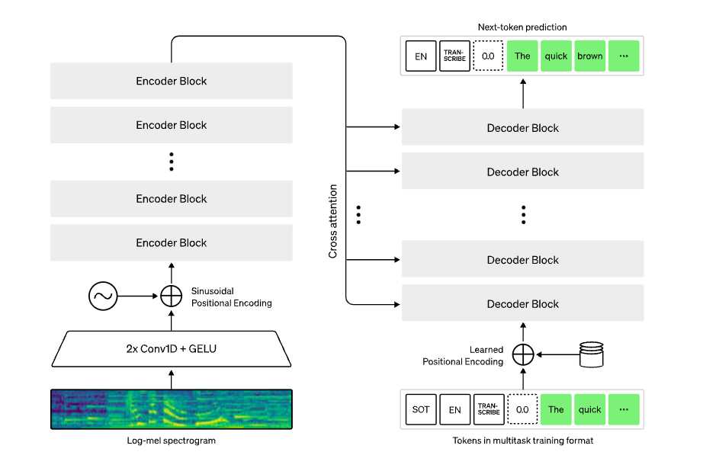
Whisper AI

Slide 10
Whisper AI
Size | Parameters | English-only model | Multilingual model | Required VRAM | Relative speed
tiny | 39 M | tiny.en | tiny | ~1 GB | ~32x
base | 74 M | base.en | base | ~1 GB | ~16x
small | 244 M | small.en | small | ~2 GB | ~6x
medium | 769 M | medium.en | medium | ~5 GB | ~2x
large | 1550 M | N/A | large | ~10 GB | 1x

Slide 11
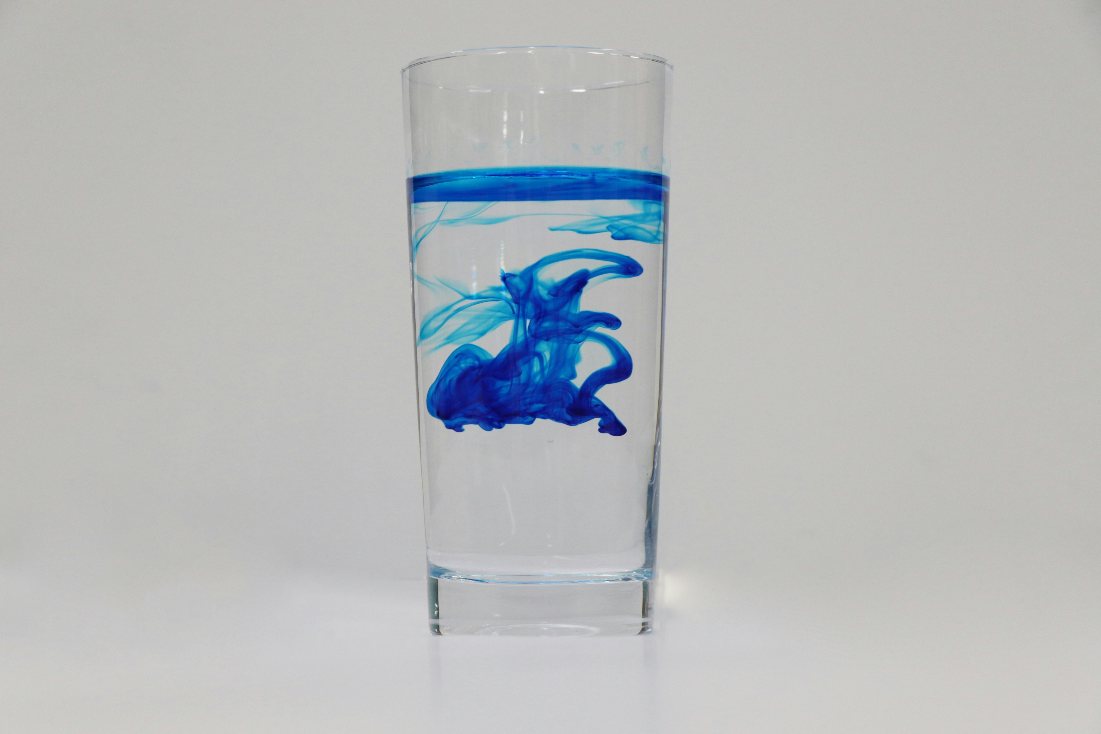
STABLE
Stable Diffusion is a text-to-image model. Given a text prompt, It will try to generate an image based on text given.
Diffusion
Belongs to a class of generative deep learning models called Diffusion models. In the case of Stable Diffusion, the data are images.
Behaves very much like diffusion in physics, hence the name.

Slide 12
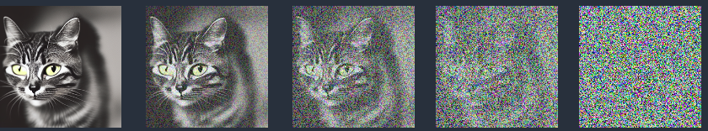
Forward Diffusion:
STABLE
Diffusion
Adds noise to a training image, gradually turning it into an UNRECOGNIZABLE noise image.
Similar to an ink drop falling into water, can no longer tell where did the drop actually fell.

Slide 13
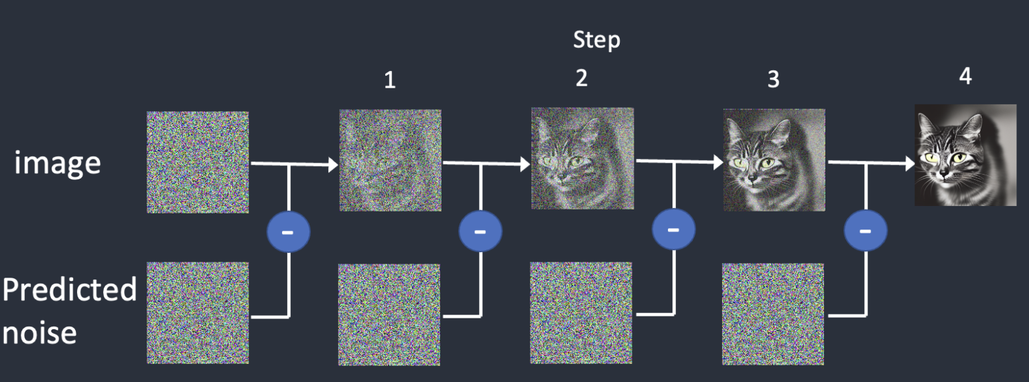
Reverse Diffusion:
STABLE
Diffusion
Works by subtracting predicted noise from a completely randomly generated noise image.
Repeat this successively until we reach the desired image(distribution).

Slide 14

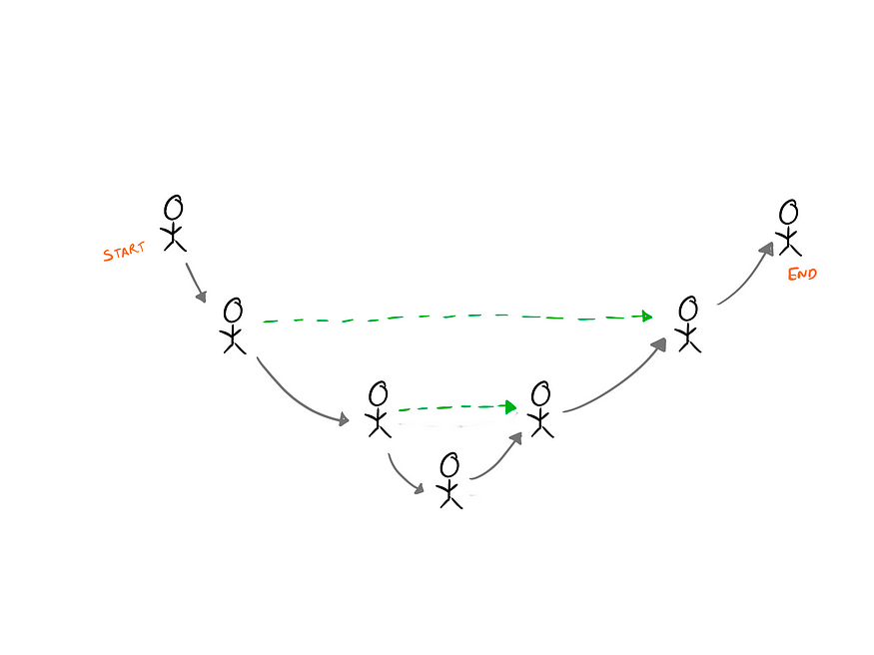
Predicted Noise
STABLE
U-Net
Diffusion
Extracts key features and compresses the image space by DOWN SAMPLING.
UP SAMPLING of the key-features.
Skip connections connect the contracting and expanding paths on the same level.
U-Net model is trained on labeled images to update the weights of the model.

Slide 15
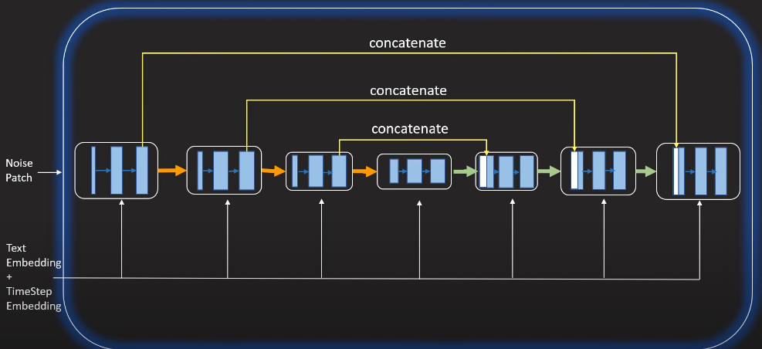
Predicted Noise
STABLE
Diffusion
Text encoder transforms the prompt text into text embeddings to add a bias in the model.

Slide 16
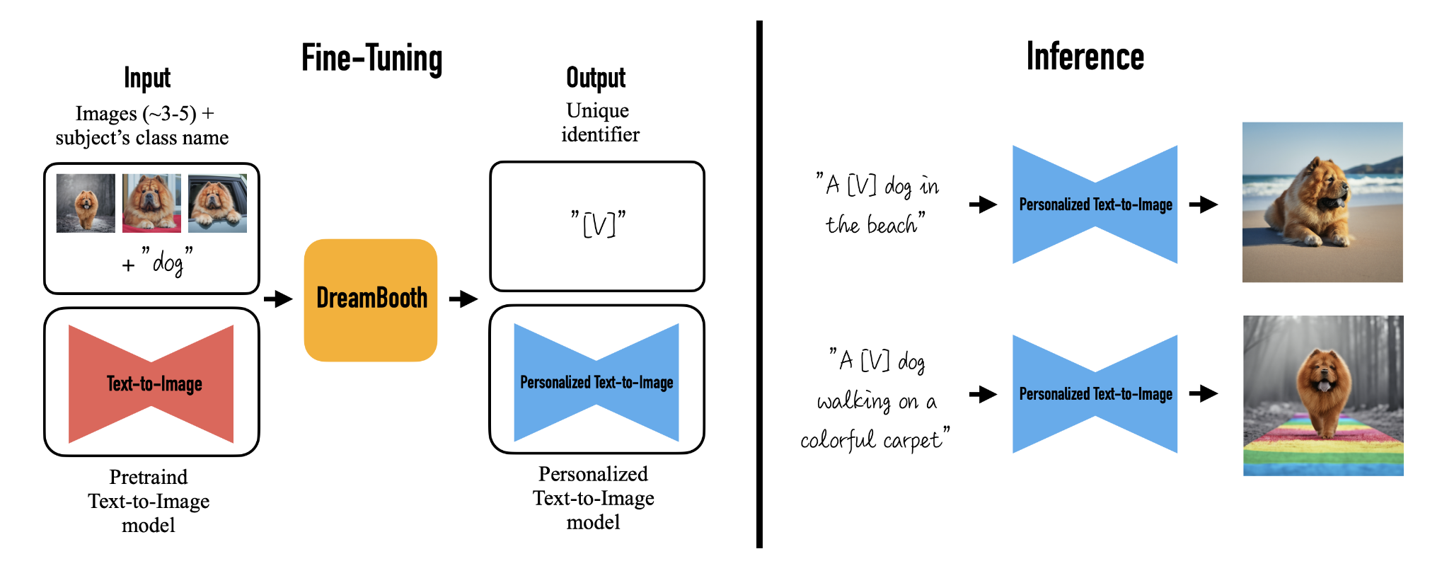
Dream Booth: Fine Tuning
STABLE
Diffusion

Slide 17


DatA
We require images for fine tuning the Stable diffusion model
For training
Target Data: Images of sign language with its meaning as labels .
Useful data for this case is a collection of short videos with their English translation as labels.
Converted the video data to a series of images by taking snapshots over regular intervals.
Notes:
How did the snaps assign an English meaning for each picture? Previously trained each of these

Slide 18


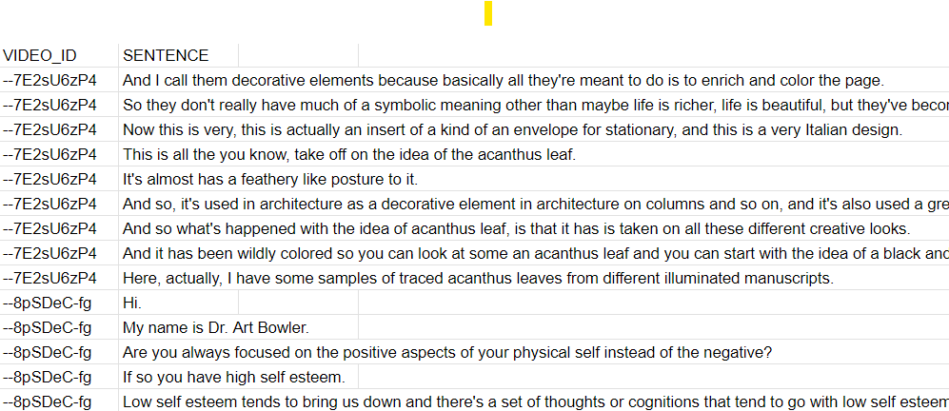
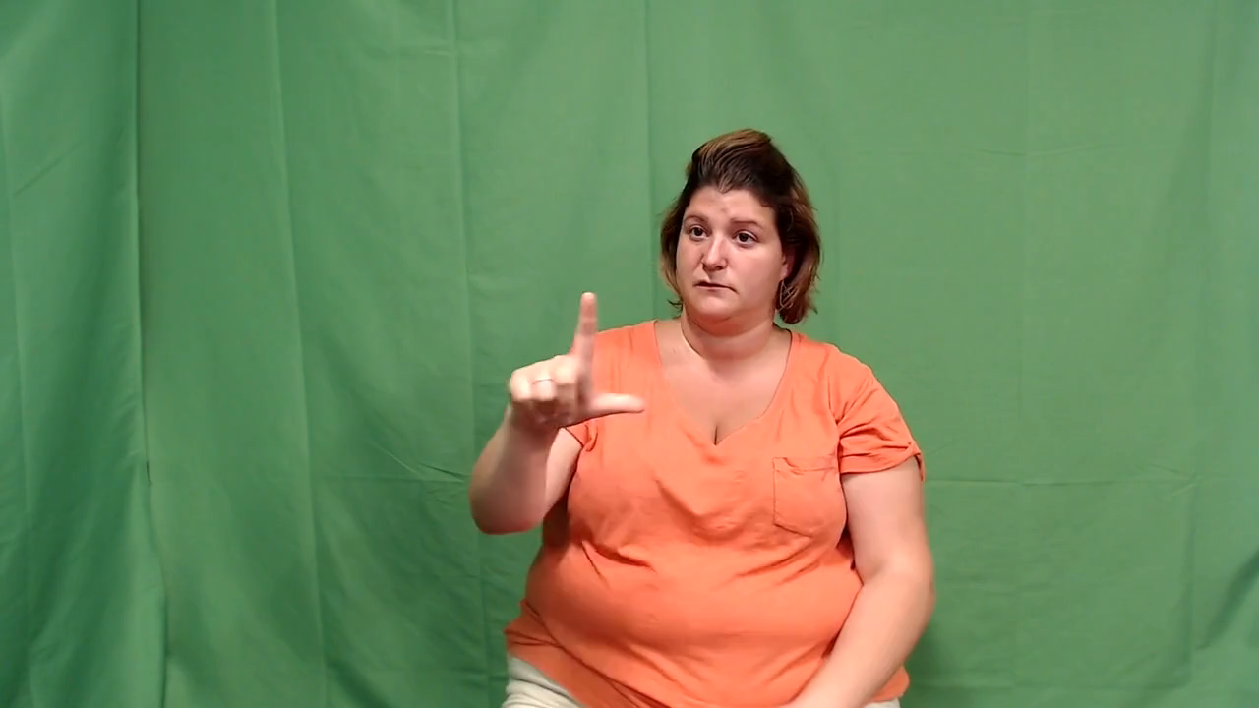
Data
For training
A CSV file for English translations as labels for each video file
More than 80 hours of sign language video files
Source: How2Sign

Slide 19

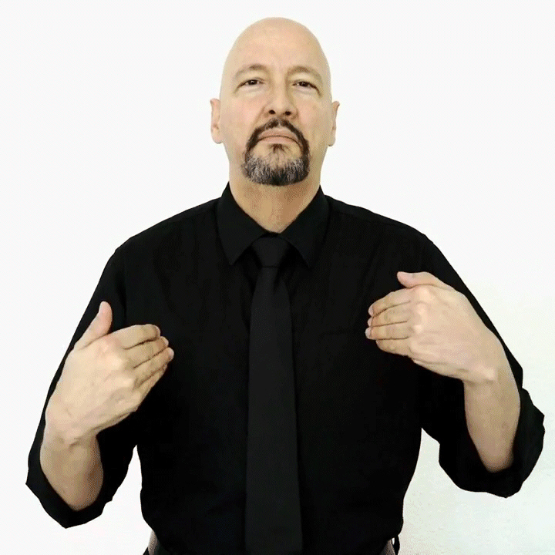
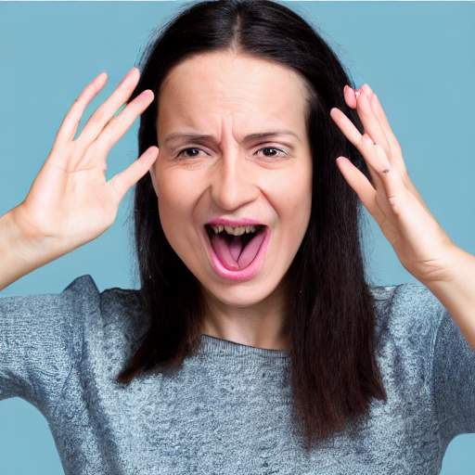
Text generation:
Model
Demonstration
Image generation:
ASL for the word ‘had’
Stable diffusion
ASL for the word ‘had’

